Slide 1

CPQ – Asia Alignment Design and Mock Up Nov ‘19
Colt confidential

Slide 2

Document Release and Change Log Details
CPQ Asia
Version Number | 0.3
Date | 27th Nov, 2019
Change log | Asia Address and Language Variation

Slide 3
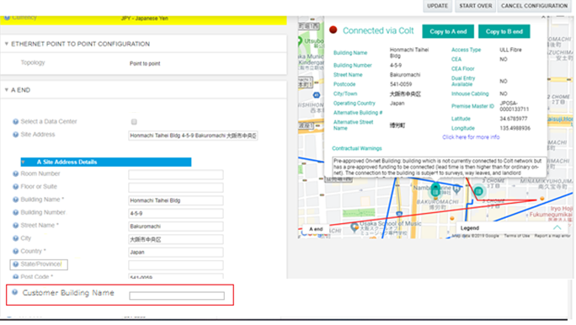
CPQ Asia : Input Asian site address: Standard Journey
There will be an additional field to allow user to optionally enter “ Customer Building Name”. Customer Building Name is a friendly name used by customer
This field will always appear while capturing site address (both for EU and Asia)
This is an optional field and CPQ will not validate the details entered
The help text needs to be updated to explain the mapping of existing CPQ attributes with Asia terminologies.
e.g. i. Building Number maps to Chome-Ban-Go in Japan
ii. City maps to Ku in Japan
iii. State maps to Prefecture
The help text for labels will include a message “Address components need to be entered in English only”
This field needs to be passed from CPQ to Siebel via Manage order
Internal and external quote download should be enhanced with ‘Customer Building Name’
Customer Building Name not to be sent for connectivity check request
CPQ UI

Slide 4
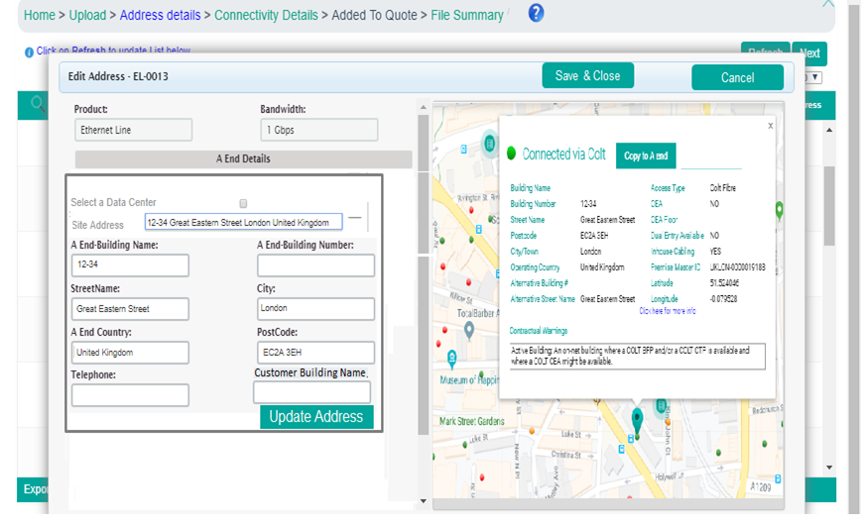
CPQ Asia : Input Asian site address: Bulk Upload Utility
There will be an additional field to allow user to optionally enter “ Customer Building Name” in Bulk upload utility.
Customer Building Name will be added on the UI but not to be used in the bulk templates

Slide 5
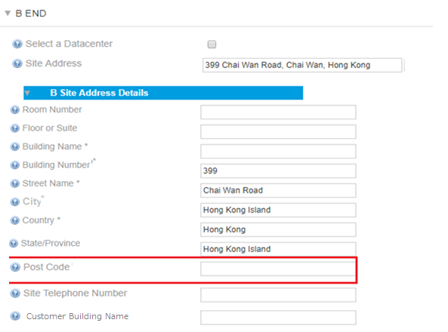
CPQ Asia : Post Code non mandatory for Hong Kong addresses
HL
Postcode will not be mandatory for Hong Kong

Slide 6
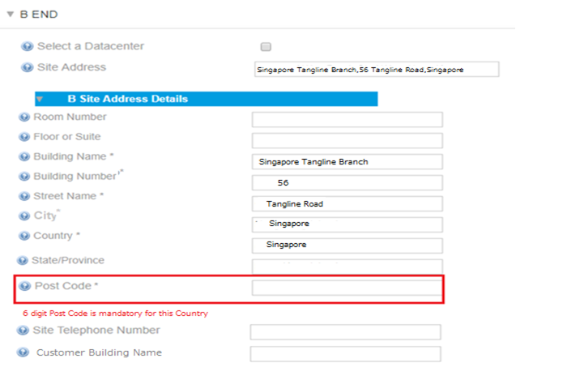
CPQ Asia : 6 digit Post Code mandatory for Singapore addresses
HL
6 digit Postcode will be mandatory for connectivity check when country is Singapore. Leading zero on the post code should be acceptable
Eg: 1, STRAITS BOULEVARD, CHINESE CULTURAL CENTRE , 018906, Singapore
CPQ will throw an error if input country is Singapore and Postcode added is not 6 digits

Slide 7
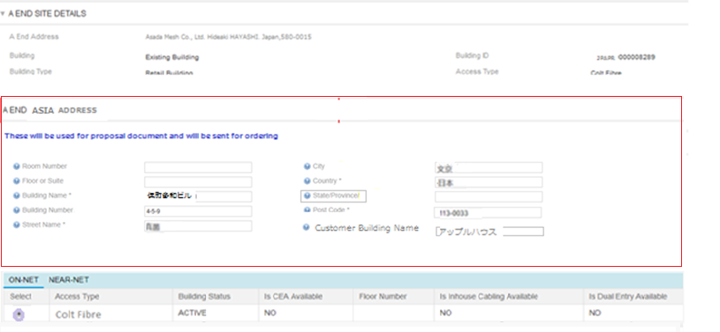
CPQ Asia : Entering Japanese address for proposal
CPQ UI
User will be given a collapsible section in Site Details tab to enter the site address in Japanese.
CPQ will not validate the fields entered. These fields are optional .
The labels will be in English only .
Help Text for the Asian address fields will include a message that “Address in Japanese to be added here”
Quote line item grid – No change
External Quote download sheet – These fields will show in the Site address A End/B End in quote download template-external. Also, customer building name to be shown in the new column
The Asian site address components will also be passed to Siebel, in case present. The fields which need to be sent to Siebel are ‘Street Name’ , ‘City’, State, ‘Building Name’
User should be able to configure/capture Native address fields via Revise commercial till the order is placed from CPQ

Slide 8
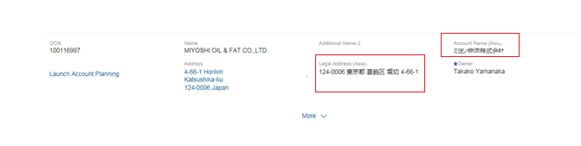
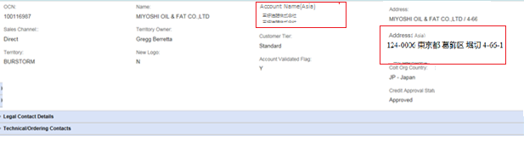
CPQ Asia : Quote Management- Account Name (Asia)
C4C screen (No change)
CPQ will consume Account Name (Asia) and show the new field under accounts section at the UI at quote information page
The new field will have label Account Name (Asia) and will be read only
Quote Download Sheet:
Account Name (Asia) will be mapped to the Account field in the external quote download sheet-Japanese
CPQ UI

Slide 9
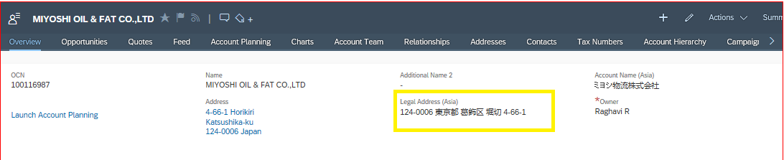
CPQ Asia : Quote Management- Account Address (Asia)
C4C screen (No change)
CPQ:
CPQ will show new field Address (Asia) under accounts section. This will be mapped to Legal Address (Asia) field in C4C. It is read-only and one-text field.
CPQ screen

Slide 10
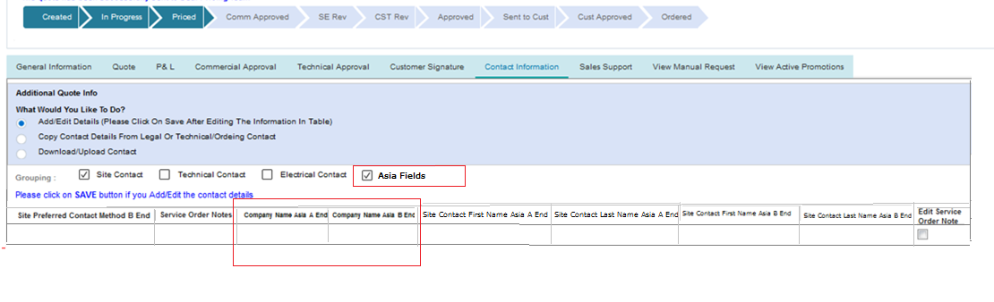
CPQ Asia : Company Name Asia
There will be a new check box under Contact Information Tab to allow user to enter Asia fields
Company Name (Asia) will be an optional field that can be captured in CPQ when user ticks “Asia fields”
This can be captured for A End and B End
The fields will be shown in the proposal document when captured

Slide 11
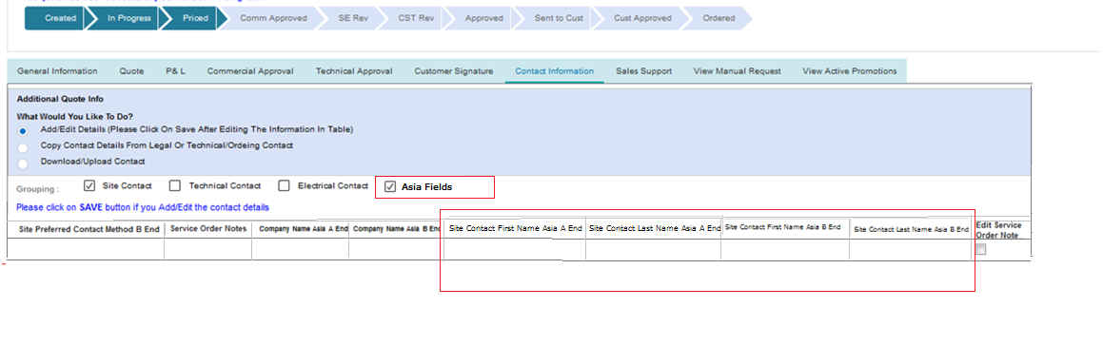
CPQ Asia : Site Contact Name Asia
Site Contact First Name Asia and Site Contact Last Name Asia will be optional fields for both A End and B End that can be captured in CPQ under Contact Information tab when user ticks “Asia fields”
These can be captured for both Site A and Site B
The fields will be shown in the proposal document when captured
Fields will be required in download and upload templates.
No OCH integration Required for these site level contact fields

Slide 12
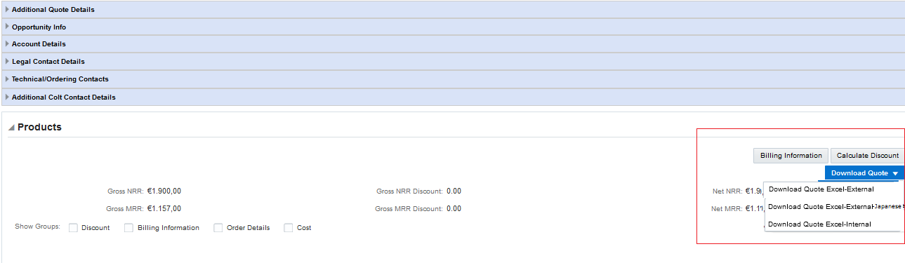
CPQ Asia : Quote Download Sheet
‘External Quote Download Sheet- Japanese’ option will be introduced . This will be a global change and will be visible to all user groups
All static labels in External Quote Download Sheet- Japanese will be in Japanese.
All fields that have Japanese values (if available in the system)- Account Name, Site addresses , Customer Building Name will be shown in Japanese characters in external quote download sheet-Japanese otherwise blank values will be shown
External Quote download template Url-
https://coltinternal.sharepoint.com/:x:/r/sites/isu/Quote%20to%20Bill%20Programme/Quote/DocCollaboration/Shared%20Documents/CPQ%20Asia/Requirements/Requirements/Proposal,%20Translations,%20Quote%20Download/Quote%20Download%20External_Sample%20Asia.xlsx?d=w8ea81ee1e9a34943bc7b630035feb46c&csf=1&e=lcVWAu
Internal Quote download template Url-
https://coltinternal.sharepoint.com/:x:/r/sites/isu/Quote%20to%20Bill%20Programme/Quote/DocCollaboration/Shared%20Documents/CPQ%20Asia/Requirements/Requirements/Proposal,%20Translations,%20Quote%20Download/Quotedownload-INTERNAL_Mocked%20Up%20Asia.xlsx?d=w50580e357f02455db38b1ab6b387d644&csf=1&e=Xi9BcH

Slide 13
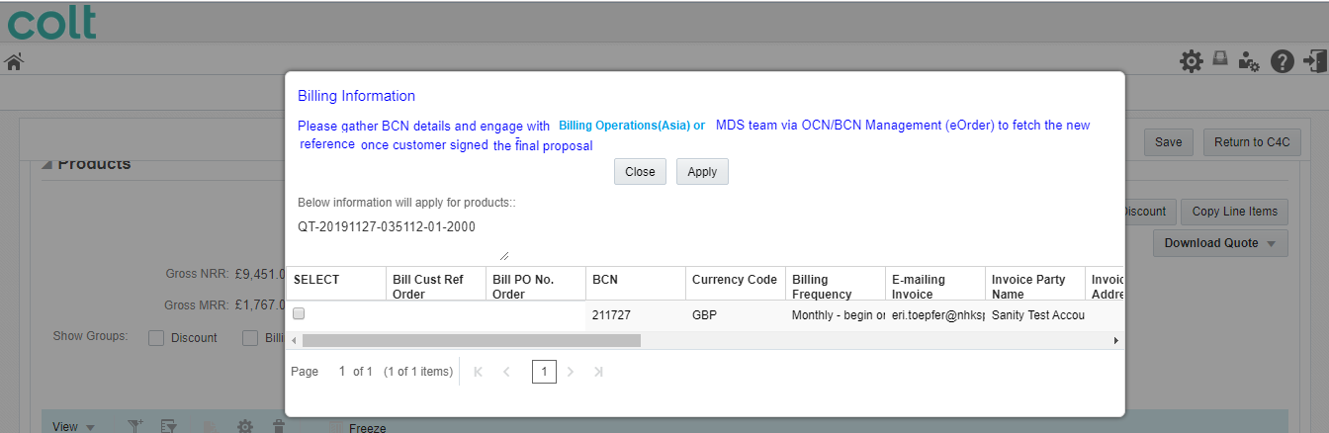
CPQ Asia : New BCN Generation
Billing Operations team is required to be engaged offline for new BCN generation in Asia.
Existing information message will be enhanced . Message shown will be “Please gather BCN details and engage with Billing operations(Asia) or MDS team via OCN/BCN Management (eOrder) to fetch the new reference once customer signed the final proposal”

